Slide 1
STUDENT ACCOMODATION SYSTEM (Using Preference Matching)
BY MARYAM ABBA YUSUF
BU/22B/IT/6965

Slide 2
INTRODUCTION
Many students encounter difficulties finding suitable accommodation after being admitted to university. To address this issue, a Student Accommodation System has been developed to assist students in finding hostels that meet their specific requirements through preference matching. It simplifies the search process, reduces the stress associated with finding accommodation, and ensures that recommendations reflect their individual preferences. For hostel owners, it enhances visibility and extends their reach within the city, potentially resulting in increased bookings

Slide 3
STATEMENT OF PROBLEM
Students often struggle to find suitable accommodation due to limited knowledge of available options and difficulty matching their preferences with available housing and roommates. This project addresses these challenges by proposing a Student Accommodation System Using Preference Matching, which helps students find accommodation that aligns with their specific needs, simplifying the search process and improving satisfaction.

Slide 4
AIMS AND OBJECTIVES
The main aim of this project is to design and implement a student accommodation using preference matching to match users with a roommate base on their preferences.
To develop a comprehensive and user-friendly software that assists student in finding suitable Accommodation
To create a booking and reservation system that allows users to secure their chosen Accommodation, manage bookings, and handle payment transactions.
To develop a user-friendly platform where students can create profiles specifying their accommodation requirements (location, lifestyle preferences).

Slide 5
SIGNIFICANCE
It ensures that students find suitable accommodation quickly and accurately.
It provides users with a preference page which allows them to choose an accommodation based on their location.
It reduces the time and effort required for manual accommodation.
Helps in efficient allocation and management of housing resources.

Slide 6
HOW THE PREFERENCE WORKS
After login, students specify their roommate preferences: cleanliness, sleep habits, quietness, and social behavior.
It Filters rooms based on the student’s preferences, showing only those that align with gender and other requirements.
The system evaluates compatibility by comparing a student’s preferences (cleanliness, quietness, social behavior) with those of current occupants.
For each preference, it calculates the absolute difference between the student’s and the occupant's preferences.
The score is then converted into a match percentage: the smaller the total difference, the higher the match percentage.
Rooms are ranked from highest to lowest match percentage, showing the best-fitting options first.

Slide 7
LITERATURE REVIEW
Related Work | Method/Approach | Strengths | Weaknesses
Chen et al. (2015) | Fuzzy-based decision-making | Handles uncertainty in preferences | Limited scalability and Requires precise preference weights
Abdullah et al. (2019) | Student Accommodation Preference Analysis Using Analytic Hierarchy Process | Effective in analyzing student accommodation preferences | Limited geographical scope (single university)
Aggarwal, C. C. (2016) | Knowledge-based recommender systems | Comprehensive suite of tools, user-friendly interface, supports various constraints and preferences | Requires significant technical expertise and resources for implementation and customization
Basavesh et al, (2023). | Location-Based Recommendation System | Hostel Finder: for Hostels and PGS with Transit | User modelling and user-adapted interaction.
Dejo, el tal, (2015) | Recommendation systems | Principles, methods and evaluation. | Specific limitations not mentioned in the document
Ekstrand, et al, (2015) | Collaborative filtering recommender systems | Foundations and Trends in Human-Computer Interaction | Theoretical Aspects and Real Applications

Slide 8

AGILE METHODOLOGY
The Agile methodology is ideal for the Student Accommodation System due to its dynamic and flexible approach. Agile supports continuous collaboration and iterative development, which means we can regularly review and adjust the system based on feedbacks. This incremental development approach allows us to refine features like preference matching and room filtering throughout the project, ensuring the final product effectively meets students' requirements.

Slide 9
Tools and Technique
Next.js is been used on both front-end and back-end for structure, styling, and recommendation. PostgreSQL is used on the back-end to generate dynamic content and store/access data from a database.
Operating System: Windows
Database: PostgreSQL
Application program: VS Code
Next.js(javascript)

Slide 10
FUNCTIONAL REQUIREMENT
Req. No. | Description | Type
R-101 | The operating system must be Windows 7 or a later version. | Configuration
R-102 | Users must have the ability to register using their email and password. | Functional
R-103 | Users should have the capability to see the list of available rooms.. | Functional
R-104 | Users need to be able to complete the payment process. | Functional
R-105 | Users must be allowed to create their profiles. | Functional
R-106 | Users should have the option to view potential matches.. | Functional
R-107 | The administrator should have access to pending payment records. | Functional
R-108 | The administrator needs to have the ability to add rooms. | Functional
R-109 | The administrator must be able to update room information. | Functional
R-110 | The administrator should be able to delete a room from the system. | Functional
R-111 | The system must permit users to input 4 preferences for filtering desirable rooms. | Functional
R-112 | The system must use the student's preferences to match and display suitable rooms. | Functional

Slide 11
NON-FUNCTIONAL REQUIREMENT
Req. No. | Description | Type
NR-101 | When launched, the application will continue to operate unless there is a deliberate shutdown of the application or the platform.. | Performance
NR-102 | Availability the system is available to everyone | Performance
NR-103 | The system should be easy to use and user-friendly | Usability
NR-104 | Efficient maintenance of the application is required. | Efficiency

Slide 12
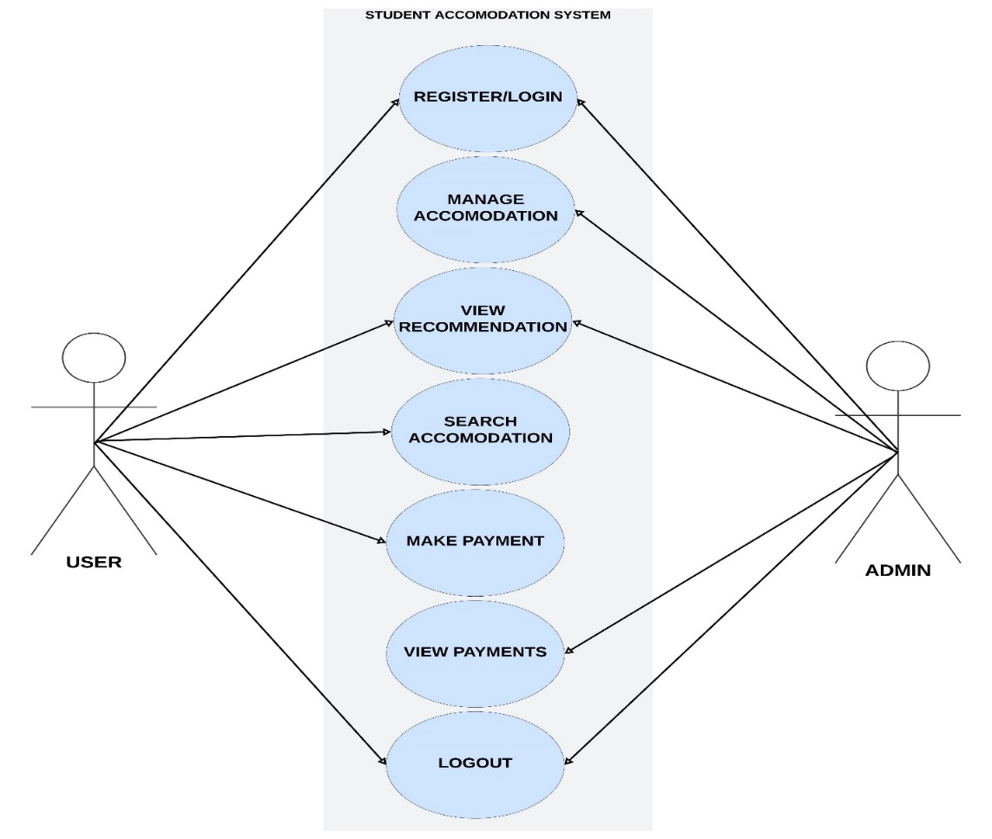
UML DIAGRAM(Use case diagram)

Slide 13
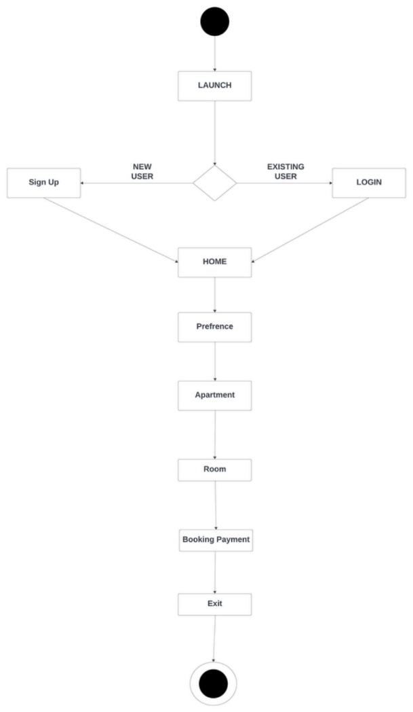
UML DIAGRAM (Activity diagram)

Slide 14
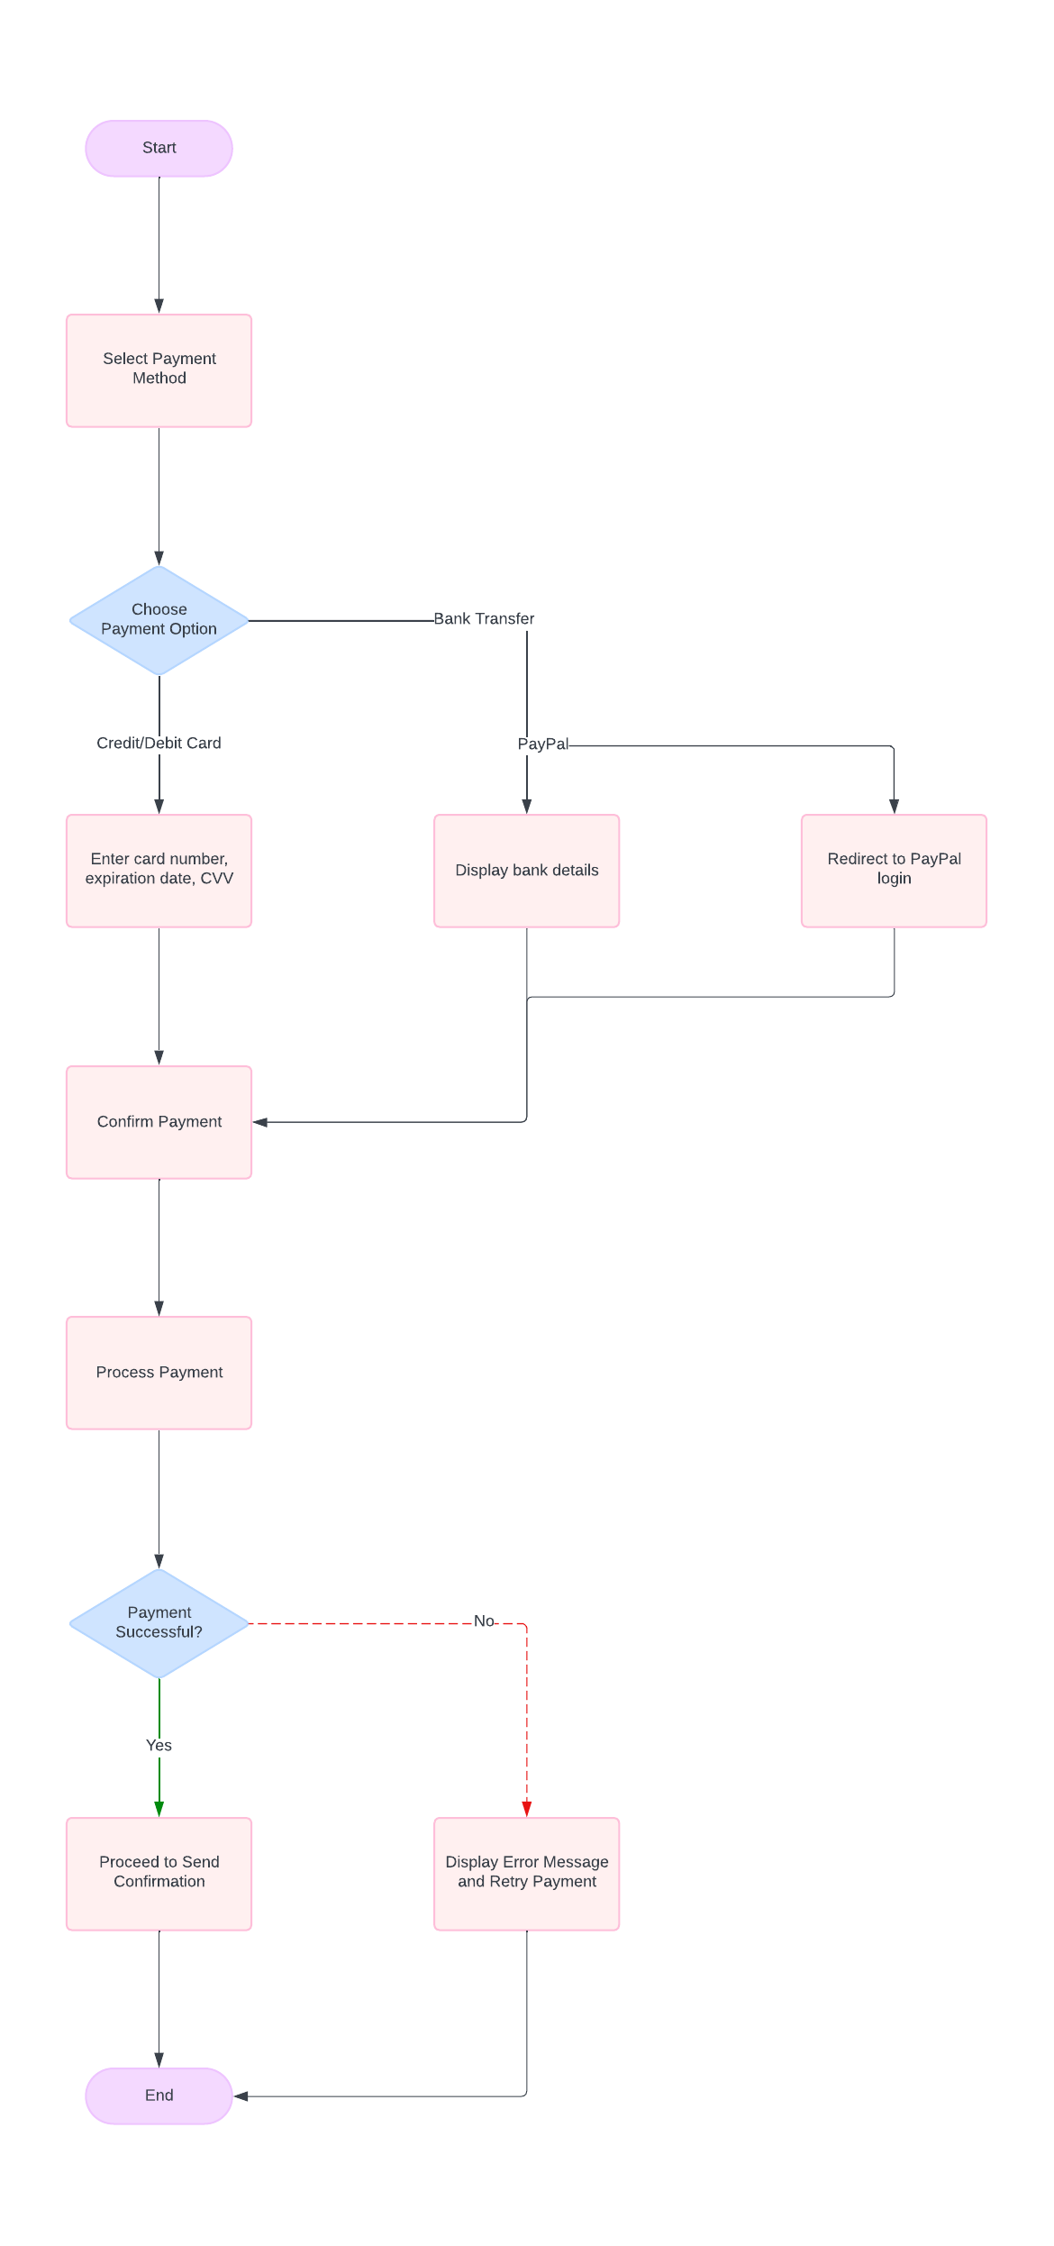

Slide 15
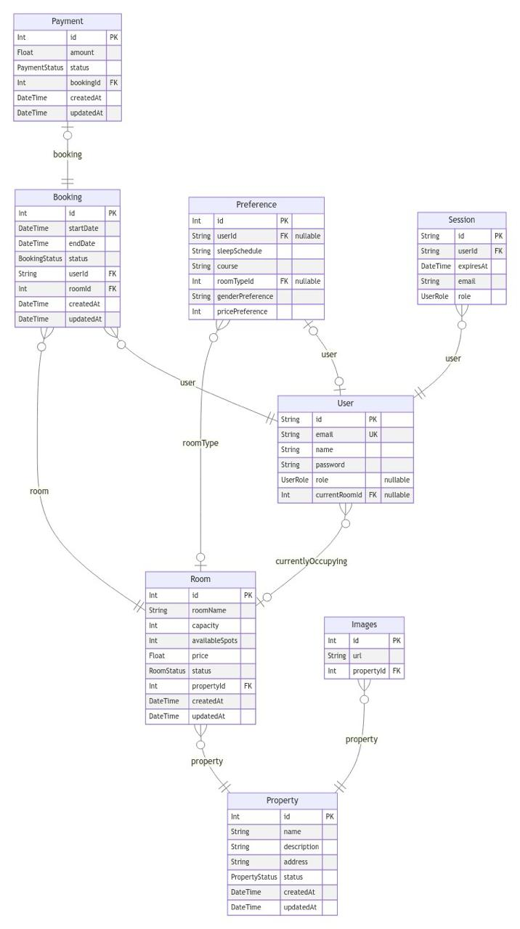
Entity Relationship Diagram

Slide 16
TESTING
Test Case | User sign in
Related Requirement | FR02
prerequisites | User has a valid account User has access to sign in page.
Test procedure | Navigate to the log in page Enter valid username and password Click on the “Sign in” button
Test Data | Valid Username and password
Expected Result | User should successfully sign in and be redirected to the home page, or a page to set preferences if not already set.
Actual Result | sign in successful
Status | pass
Remark | None
Created By | Maryam Abba Yusuf
Date of Creation | 10th August,2024
Executed By | Maryam Abba Yusuf
Date of Execution | 10th August, 2024
Test Environment | HP Laptop

Slide 17
Test Case | User Preference
Related Requirement | FR04
prerequisites | User has a valid account User has access to the preference page
Test procedure | Select gender preference (Male, Female, Other). Adjust sliders for cleanliness, socialness, quietness, and sleep schedule. Click on the “Submit” button
Test Data | Selected gender preference and values for cleanliness, socialness, quietness, and sleep schedule.
Expected Result | Preferences should be successfully saved, and the user should be redirected to a room recommendations page
Status | pass
Remark | None
Created By | Maryam Abba Yusuf
Date of Creation | 10th August,2024
Executed By | Maryam Abba Yusuf
Date of Execution | 10th August, 2024
Test Environment | HP Laptop

Slide 18
Test Case | Admin
Related Requirement | FR03
prerequisites | Admin has a valid account and is signed in. Admin has access to the admin management dashboard.
Test procedure | Login as Admin. Review current room availability and occupancy status. Update room availability (e.g., mark rooms as available or occupied). save changes and verify that updates are reflected in the system. View pending payment
Test Data | Room and Apartment status updates
Expected Result | Room availability and preferences should be updated successfully. The changes should be reflected in the system for users to see.
Status | pass
Remark | None
Created By | Maryam Abba Yusuf
Date of Creation | 10th August,2024
Executed By | Maryam Abba Yusuf
Date of Execution | 10th August, 2024
Test Environment | HP Laptop

Slide 19
CONCLUSION
the Student Accommodation System Using Preference Matching addresses the common challenges students face when searching for suitable housing. By leveraging user preferences, filtering available rooms, and calculating compatibility, the system simplifies the search process and improves student satisfaction.

Slide 20
REFERENCES
Aggarwal, C. C. (2016). Recommender systems. Springer International Publishing.
Breese, J. S., Heckerman, D., & Kadie, C. (1998). Empirical analysis of predictive algorithms for
collaborative filtering (Technical Report MSR-TR-98-12). Microsoft Research.
Basavesh, D., Laharishree, S., Sthuthi, S., Tejaswini, N., & Vidya, R. (2023). Hostel finder:
Location-based recommendation system for hostels and PGS with transit information. International Journal of Research Publication and Reviews. https://www.ijrpr.com
Burke, R. (2001). Knowledge-based recommender systems. In Encyclopedia of library and
information science.
Burke, R. (2002). Hybrid recommender systems: Survey and experiments. User Modeling and
User-Adapted Interaction, 12(4), 331-370.
Carpenter, S. R., Pingali, P. L., Bennett, E. M., & Zurek, M. B. (Eds.). (2005). Ecosystems and

